Slide 1
Implementation Guides
Lloyd McKenzie
July 24, 2018

Slide 2

Who am I?
Name: Lloyd McKenzie
Company: Gevity
Background:
One of FHIR’s 3 initial editors
Co-chair FMG, FHIR-I and MnM
HL7 Fellow
Heavily involved in HL7 and healthcare exchange for last 18 years (v2, v3, CDA, etc.)
lmckenzie@gevityinc.com

Slide 3
FHIR Core specification
Defines all resources & Data types
Some terminology, most elements optional
Defines REST, messaging & document interfaces
Defines initial operations, search parameters
Framework for interoperability
But only “drive-by” actual interoperability

Slide 4
For full interoperability
We need:
Specific profiles setting constraints on resources & data types
What’s mandatory? What must be supported? What terminologies? What constraints?
Additional operations, search parameters
Guidance on what architectural approaches to use
Guidance on other things (security, consent, registration, etc.)
Examples of what data should actually look like

Slide 5
FHIR Implementation Guides
Implementation Guides:
Are packages of FHIR conformance resources relevant to solving a particular interoperability need
Also include additional human-readable documentation to guide implementation
Provide support for computable validation of solutions that claim conformance with the IG
Can build on other implementation guides
Are defined by a FHIR ImplementationGuide resource

Slide 6

Who produces IGs?
HL7 International
Other SDOs (e.g. IHE)
National & regional projects
Professional organizations
Implementation projects

Slide 7
Conformance Resources
Terminology
Code System
Value Set
Naming System
Content
Structure Definition
Behavior
Operation Definition
Search Parameter
Conformance
Misc.
Implementation Guide
Test Script
Structure Map
Concept Map

Slide 8
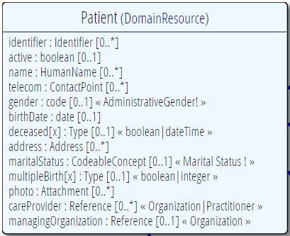
Profiling a resource
Demand that the identifier uses your national patient identifier
Limit names to just 1 (instead of 0..*)
Limit maritalStatus to another set of codes that extends the one from HL7 international
Add an extension to support “RaceCode”
Note: hardly any mandatory elements in the core spec!

Slide 9
What can profiles do?
Constrain cardinality
Constrain codes (value sets & binding strength)
Constrain & profile types
Add additional invariants
Indicate what must be supported
Define reference resolution
Add additional narrative guidance

Slide 10

CodeSystem vs. ValueSet
“Dante’s deadly sins”
Pride
Envy
Wrath
Sloth
Avarice
Gluttony
Lust
Takes concepts from…
Definition of terms
An enumeration of terms
“CodeSystem”
“ValueSet”
Example: SNOMED-CT
Example: “Childhood diseases”

Slide 11

“Special” cases
No need to write them all down!
Takes concepts from…
“All words under B”
“All words in the
Merriam-Webster dictionary”
“Words for ‘nerd’”
Bookworm
Geek
Grind
Weenie
Wonk
Dink (slang)
Dork (slang)
Takes concepts from…
Takes concepts from…
Can take concepts from multiple codingsystems

Slide 12
Conformance levels
Fixed: You must use this value set if you send the element.
If it’s a CodeableConcept, you can sent translations too
Extensible: You must use a code from this value set if one applies
Preferred: Recommend using this code system, but ok if you don’t
Example: No recommendation, may be incomplete

Slide 13
CapabilityStatements
There’s a resource for documenting conformance to FHIR
Can be used for:
Stating how a specific system instance behaves
Defining how a software system is capable of behaving (including configuration options)
Identifying a desired set of behavior (e.g. RFP)
To declare themselves “FHIR Conformant”, a system is expected to publish a CapabilityStatement instance

Slide 14
CapabilityStatements in IGs
Used to define expected capabilities of each “system” role
What resources they support
Including what profiles they must support
What operations they support
Can include SHALL/SHOULD/MAY requirements

Slide 15
Validation
Check that a FHIR instance complies with:
FHIR specification
Declared (and mandated) profiles
Current Code System & Value Set definitions
Requirements of referenced profiles & extensions

Slide 16
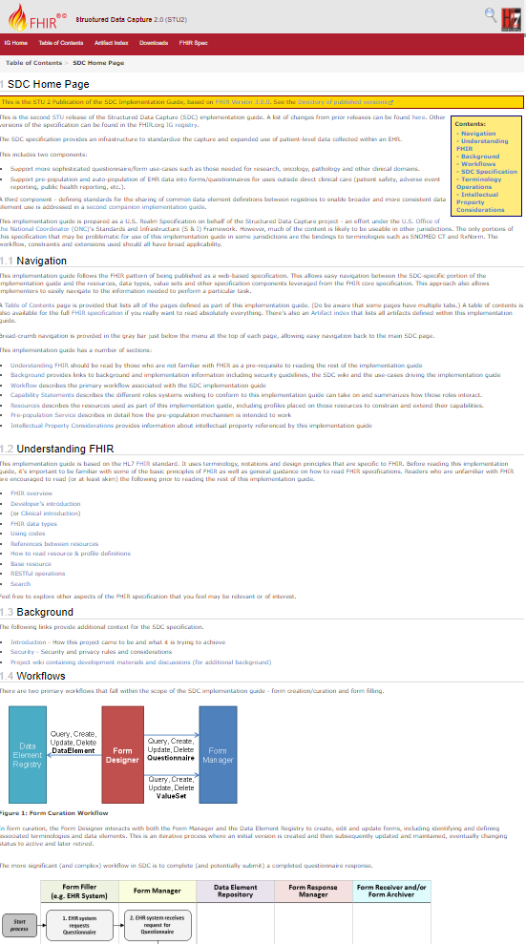
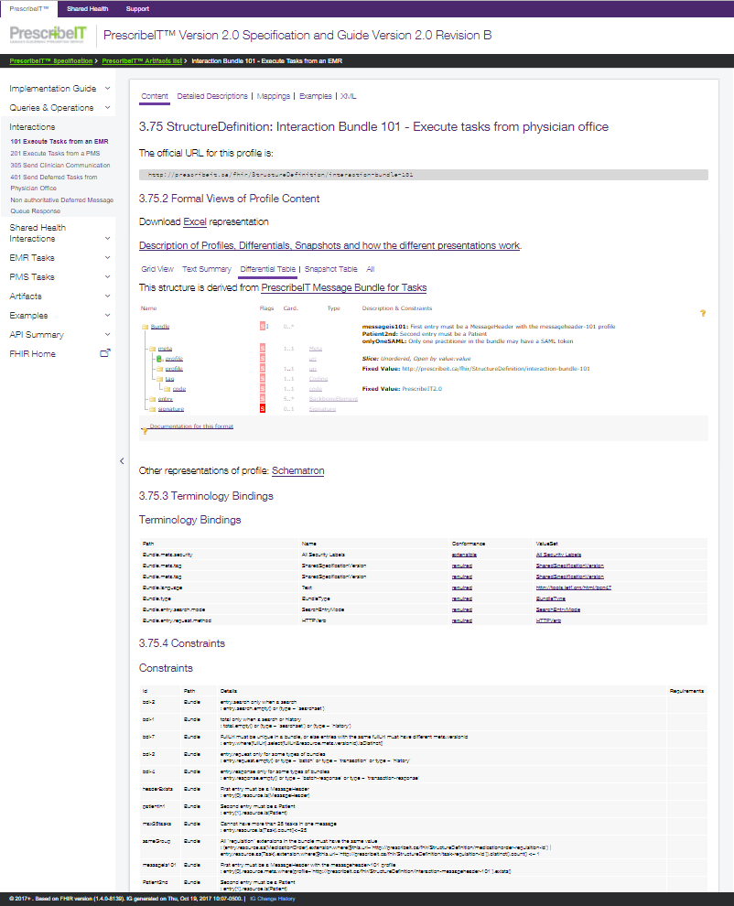
IG Inputs and Outputs
X
Config
+ “Package”
ImplementationGuide
XHTML / Markdown
pages
Conformance
resources

Slide 17
The genomics IG
Notes:
10:00

Slide 18
Walkthrough
http://build.fhir.org/ig/HL7/genomics-reporting

Slide 19

Questions?
http://hl7.org/fhir lmckenzie@gevityinc.com

